Slide 1
CSC229 Machine Learning Algorithms & Programming
Part 0.1 Introduction Applications
Peter Waiganjo Wagacha
2026

Slide 2
Branches of AI
Machine Learning
Machine vision
Speech synthesis and recognition
Robotics
Natural Language and understanding
Knowledge-based Systems
Game playing
..

Slide 3
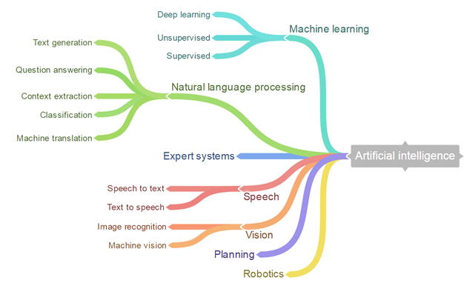

Slide 4
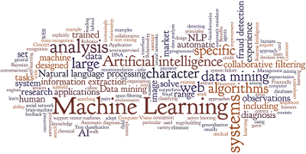
Applications, related areas

Slide 5
Application Areas
Marketing: customer segmentation, customer targeting, collaborative filtering, ...
Finance: investment support, portfolio management
Banking & Insurance: credit and policy approval
Security: fraud detection, intrusion detection, cybersecurity, spam detection
Science and medicine: hypothesis discovery, prediction, classification, diagnosis, summarization
Manufacturing: process modeling, quality control, resource allocation
Engineering: simulation and analysis, pattern recognition, signal processing
Internet: smart search engines, web marketing, sentiment analysis/opinion mining
Autonomous vehicles: driverless vehicles
Content creation: Generate images; content; tutoring, personalized learning,..

Slide 6
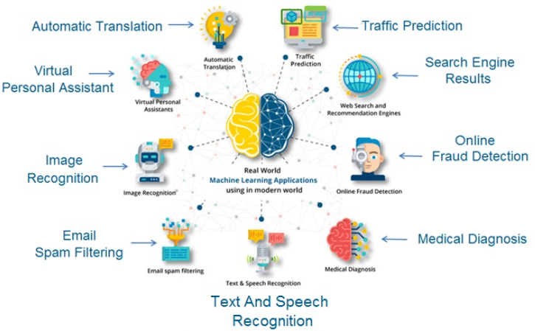
Real world Applications of Machine Learning
Source: https://www.learncomputerscienceonline.com/what-is-machine-learning/

Slide 7
Machine Learning algorithms
Machine Learning Models built using algorithms
Tens of thousands of machine learning algorithms and models
Hundreds new every year
Every machine learning algorithm has three components:
Representation (the algorithm)
Evaluation (assessing quality of the model)
Optimization (finding the optimal/best fit for the representation)
Source: Pedro Domingos Machine Learning slides

Slide 8
Other Applications
Computer vision
Signal processing
Image Recognition
Robotics
Language tools
Machine Translation
LLMs applications
…

Slide 9
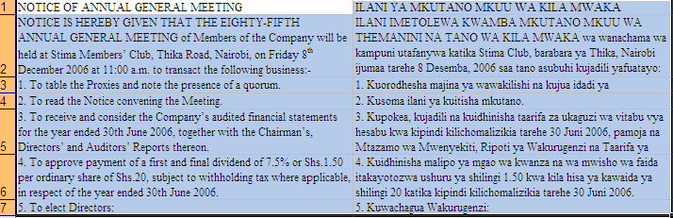
e.g. Machine Translation (MT) Using Parallel Corpus
Translation memories
Translation from one language to another using Machine Learning

Slide 10
Machine Learning in Practice
Understanding domain, prior knowledge, and goals
Data integration, selection, cleaning, pre-processing, etc.
Learning models
Interpreting results
Consolidating and deploying discovered knowledge
Loop

Slide 11
Some Results of ML
Forecast what may happen in the future
Classify people or things into groups by recognizing patterns
Clustering people or things into groups based on their attributes or features
Associating what events are likely to occur together
Sequencing what events are likely to lead to later events
Generating content using language models
Understand the public mood from social media posts

Slide 12
Discussion: Simple examples
Rent and House prices:
How can we predict rents and house prices in Nairobi and its metropolitan areas?
Spam email:
How can we separate spam and non-spam emails?
Want to watch a movie?:
How does the recommendation work?

